Slide 1
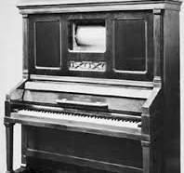
Player Piano
Laura Green
IoT Cohort 10

Slide 2
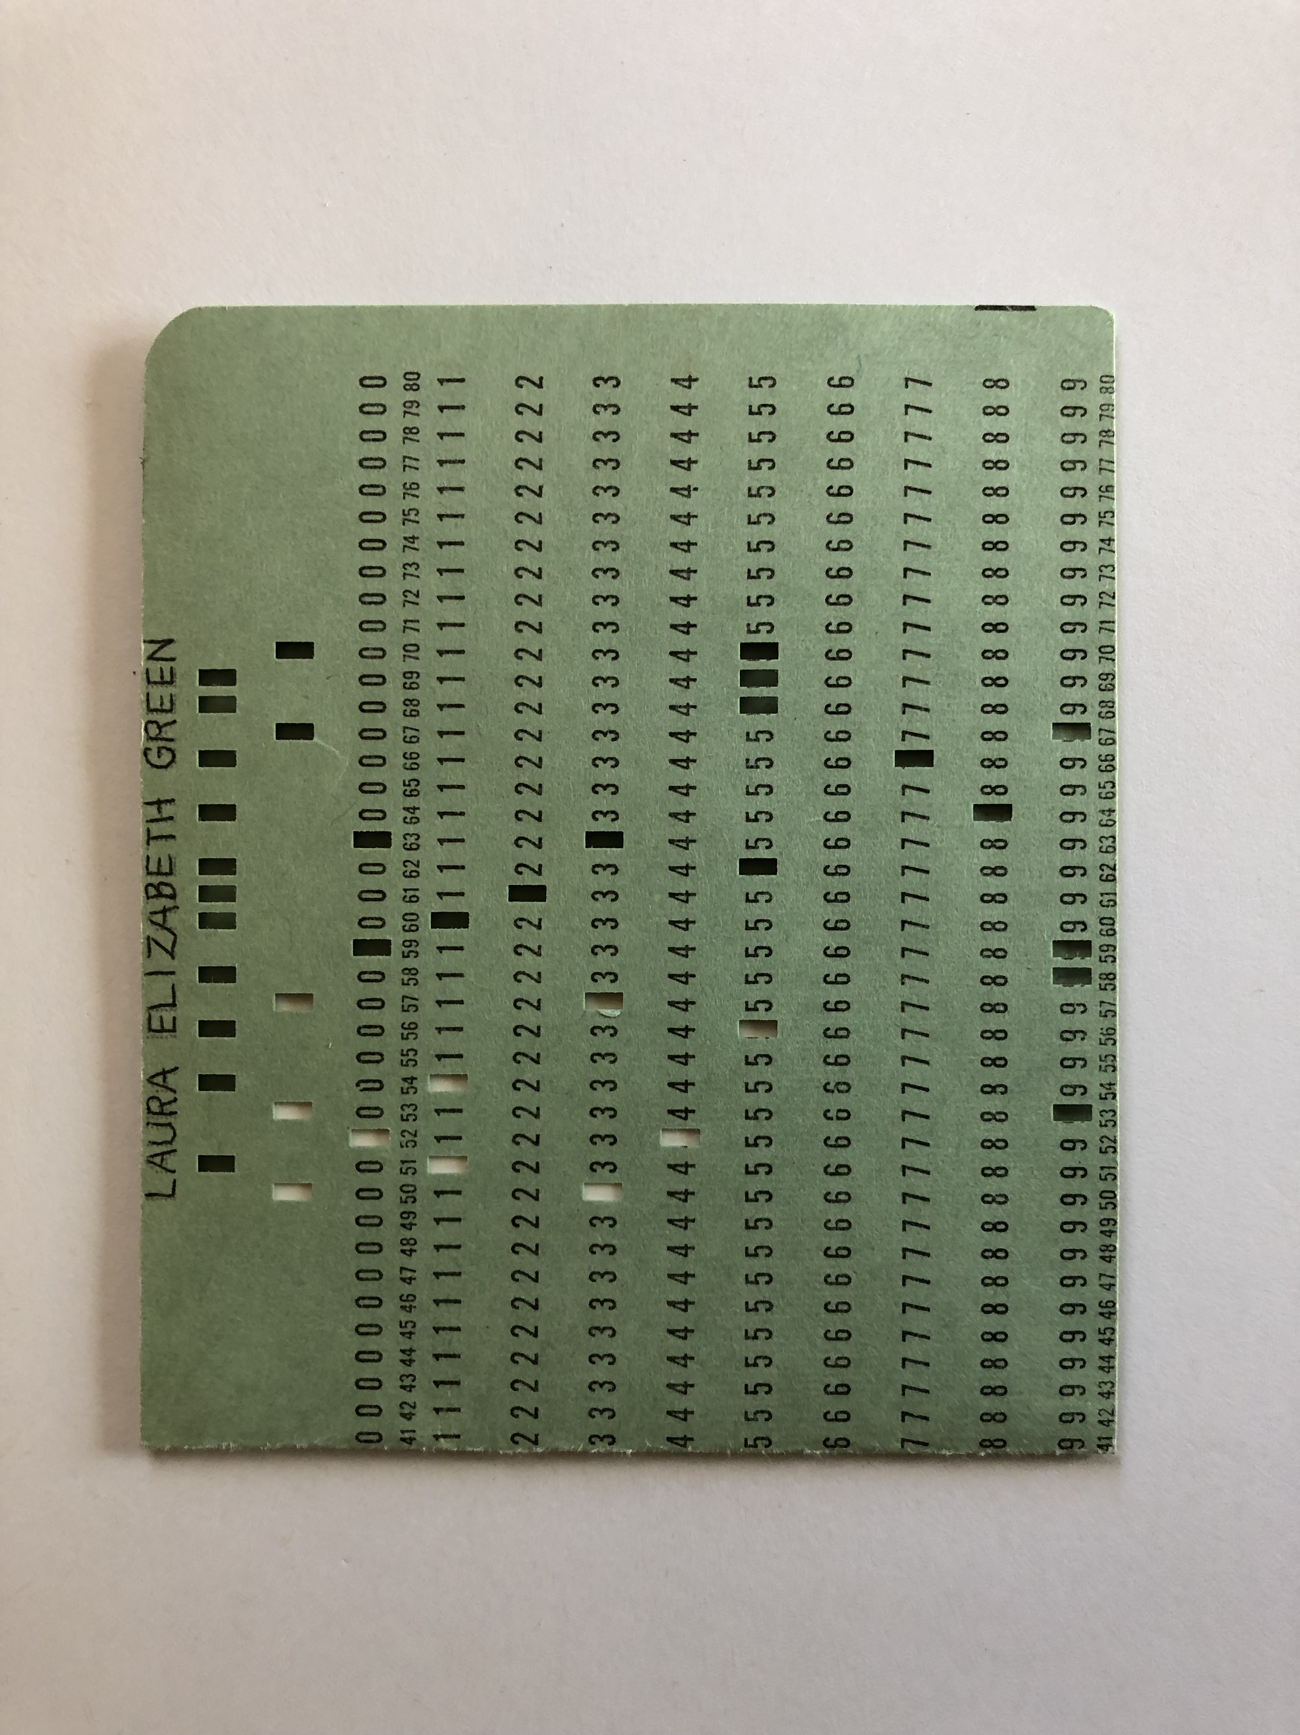
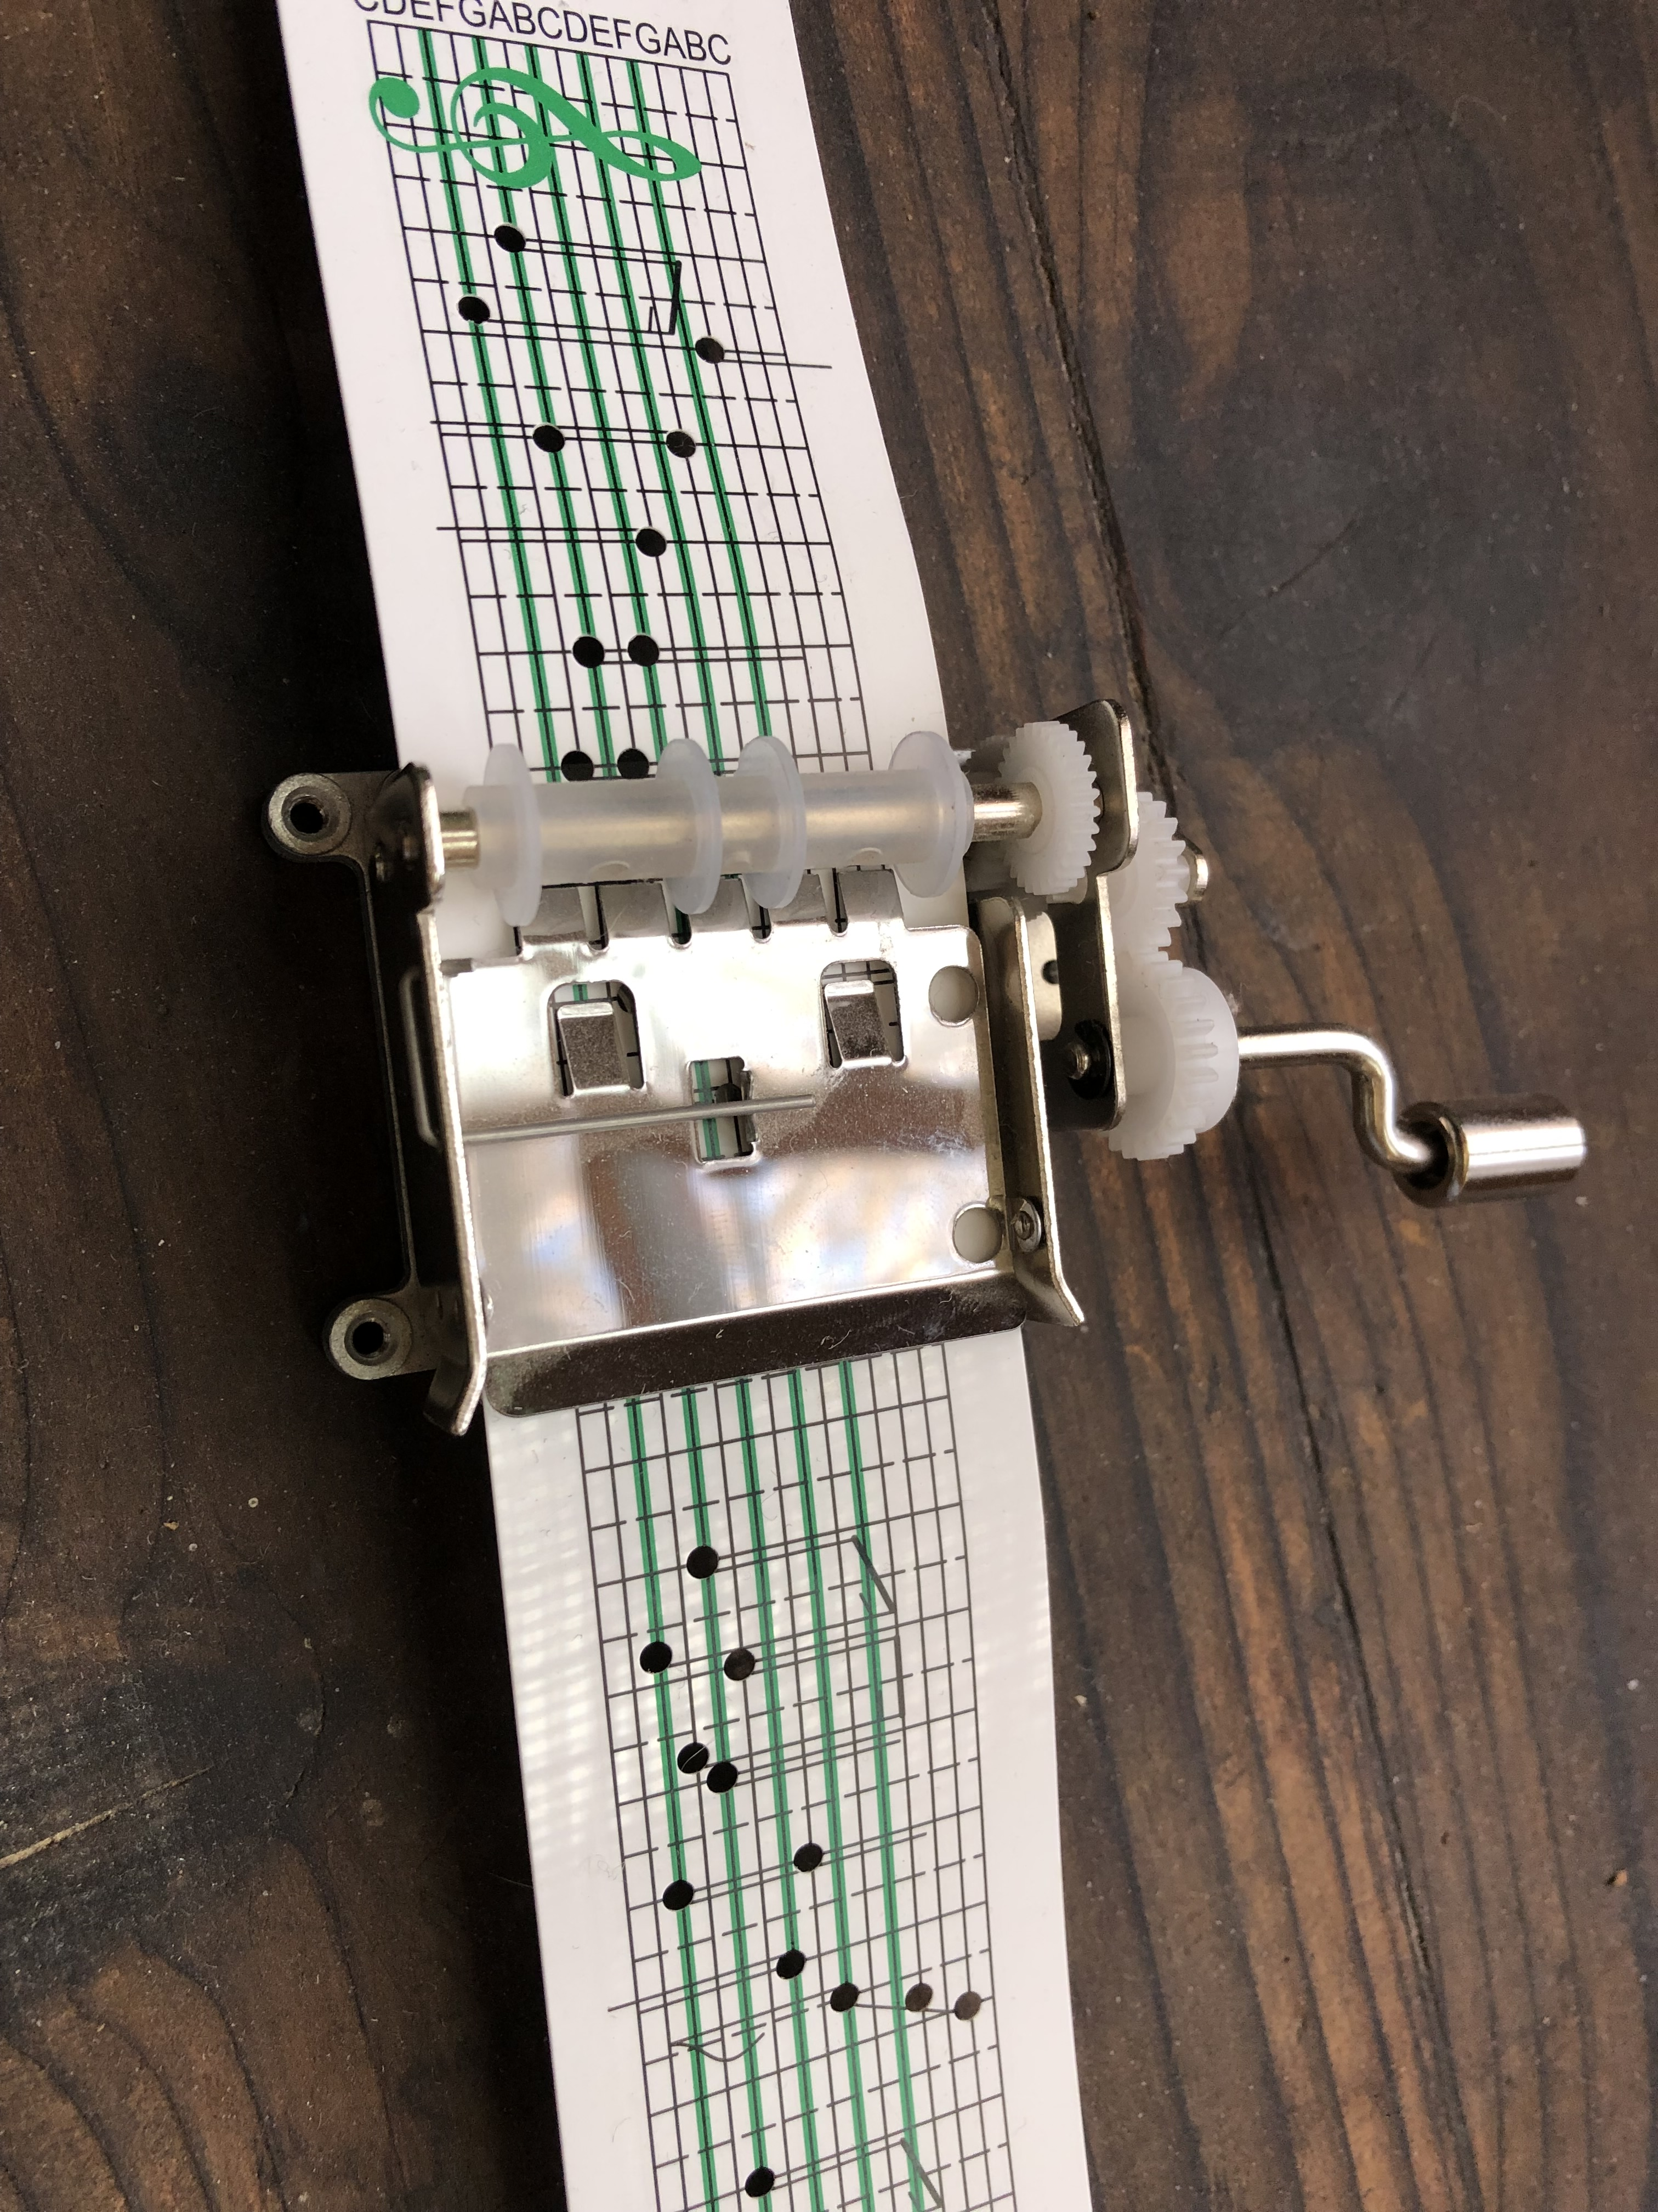
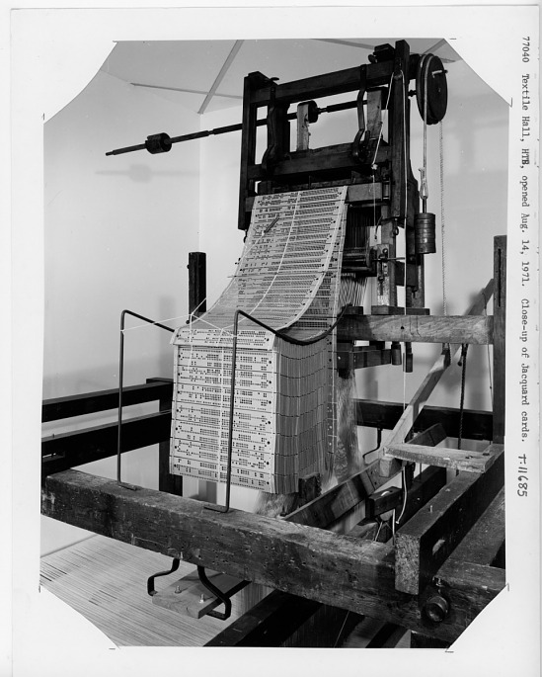
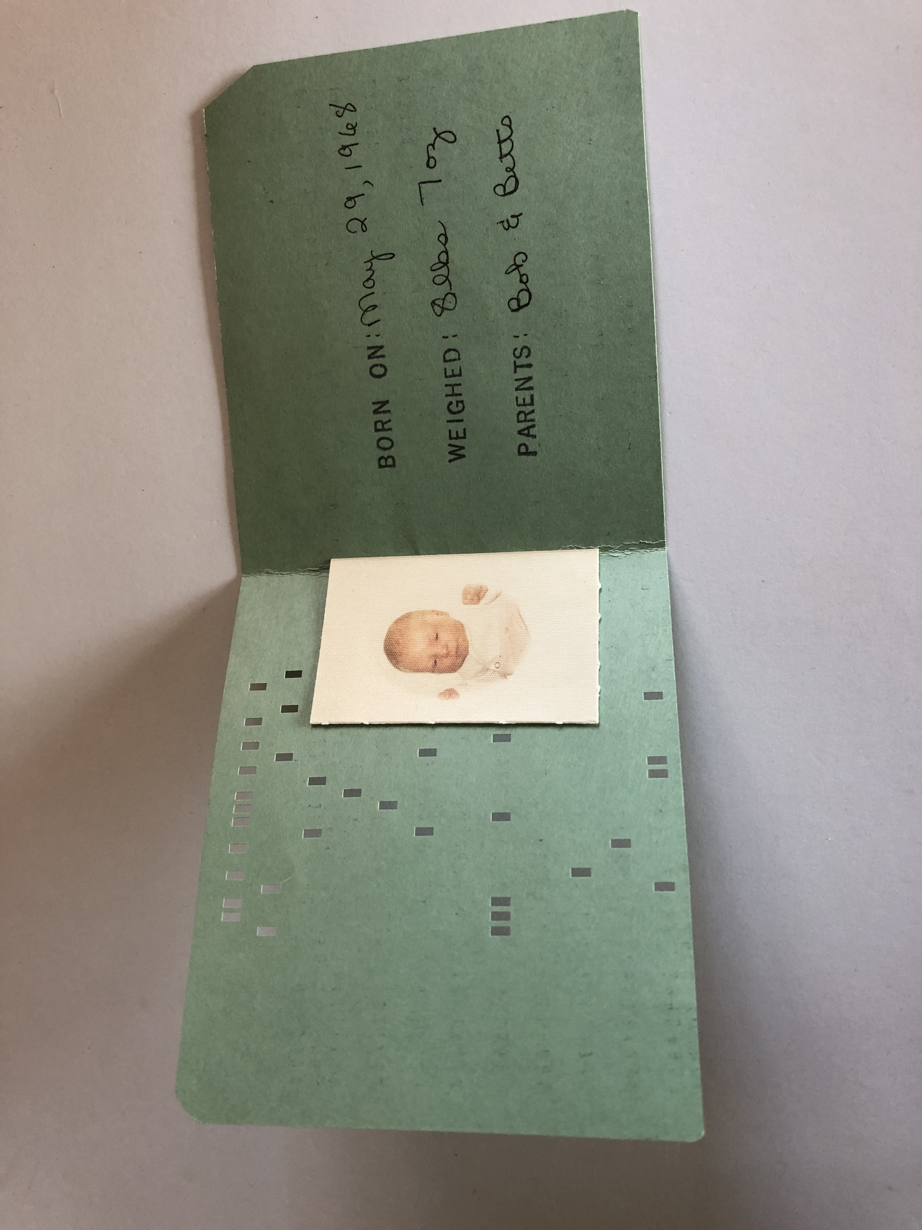
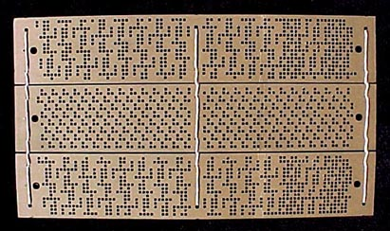
Inspirations:

Slide 3
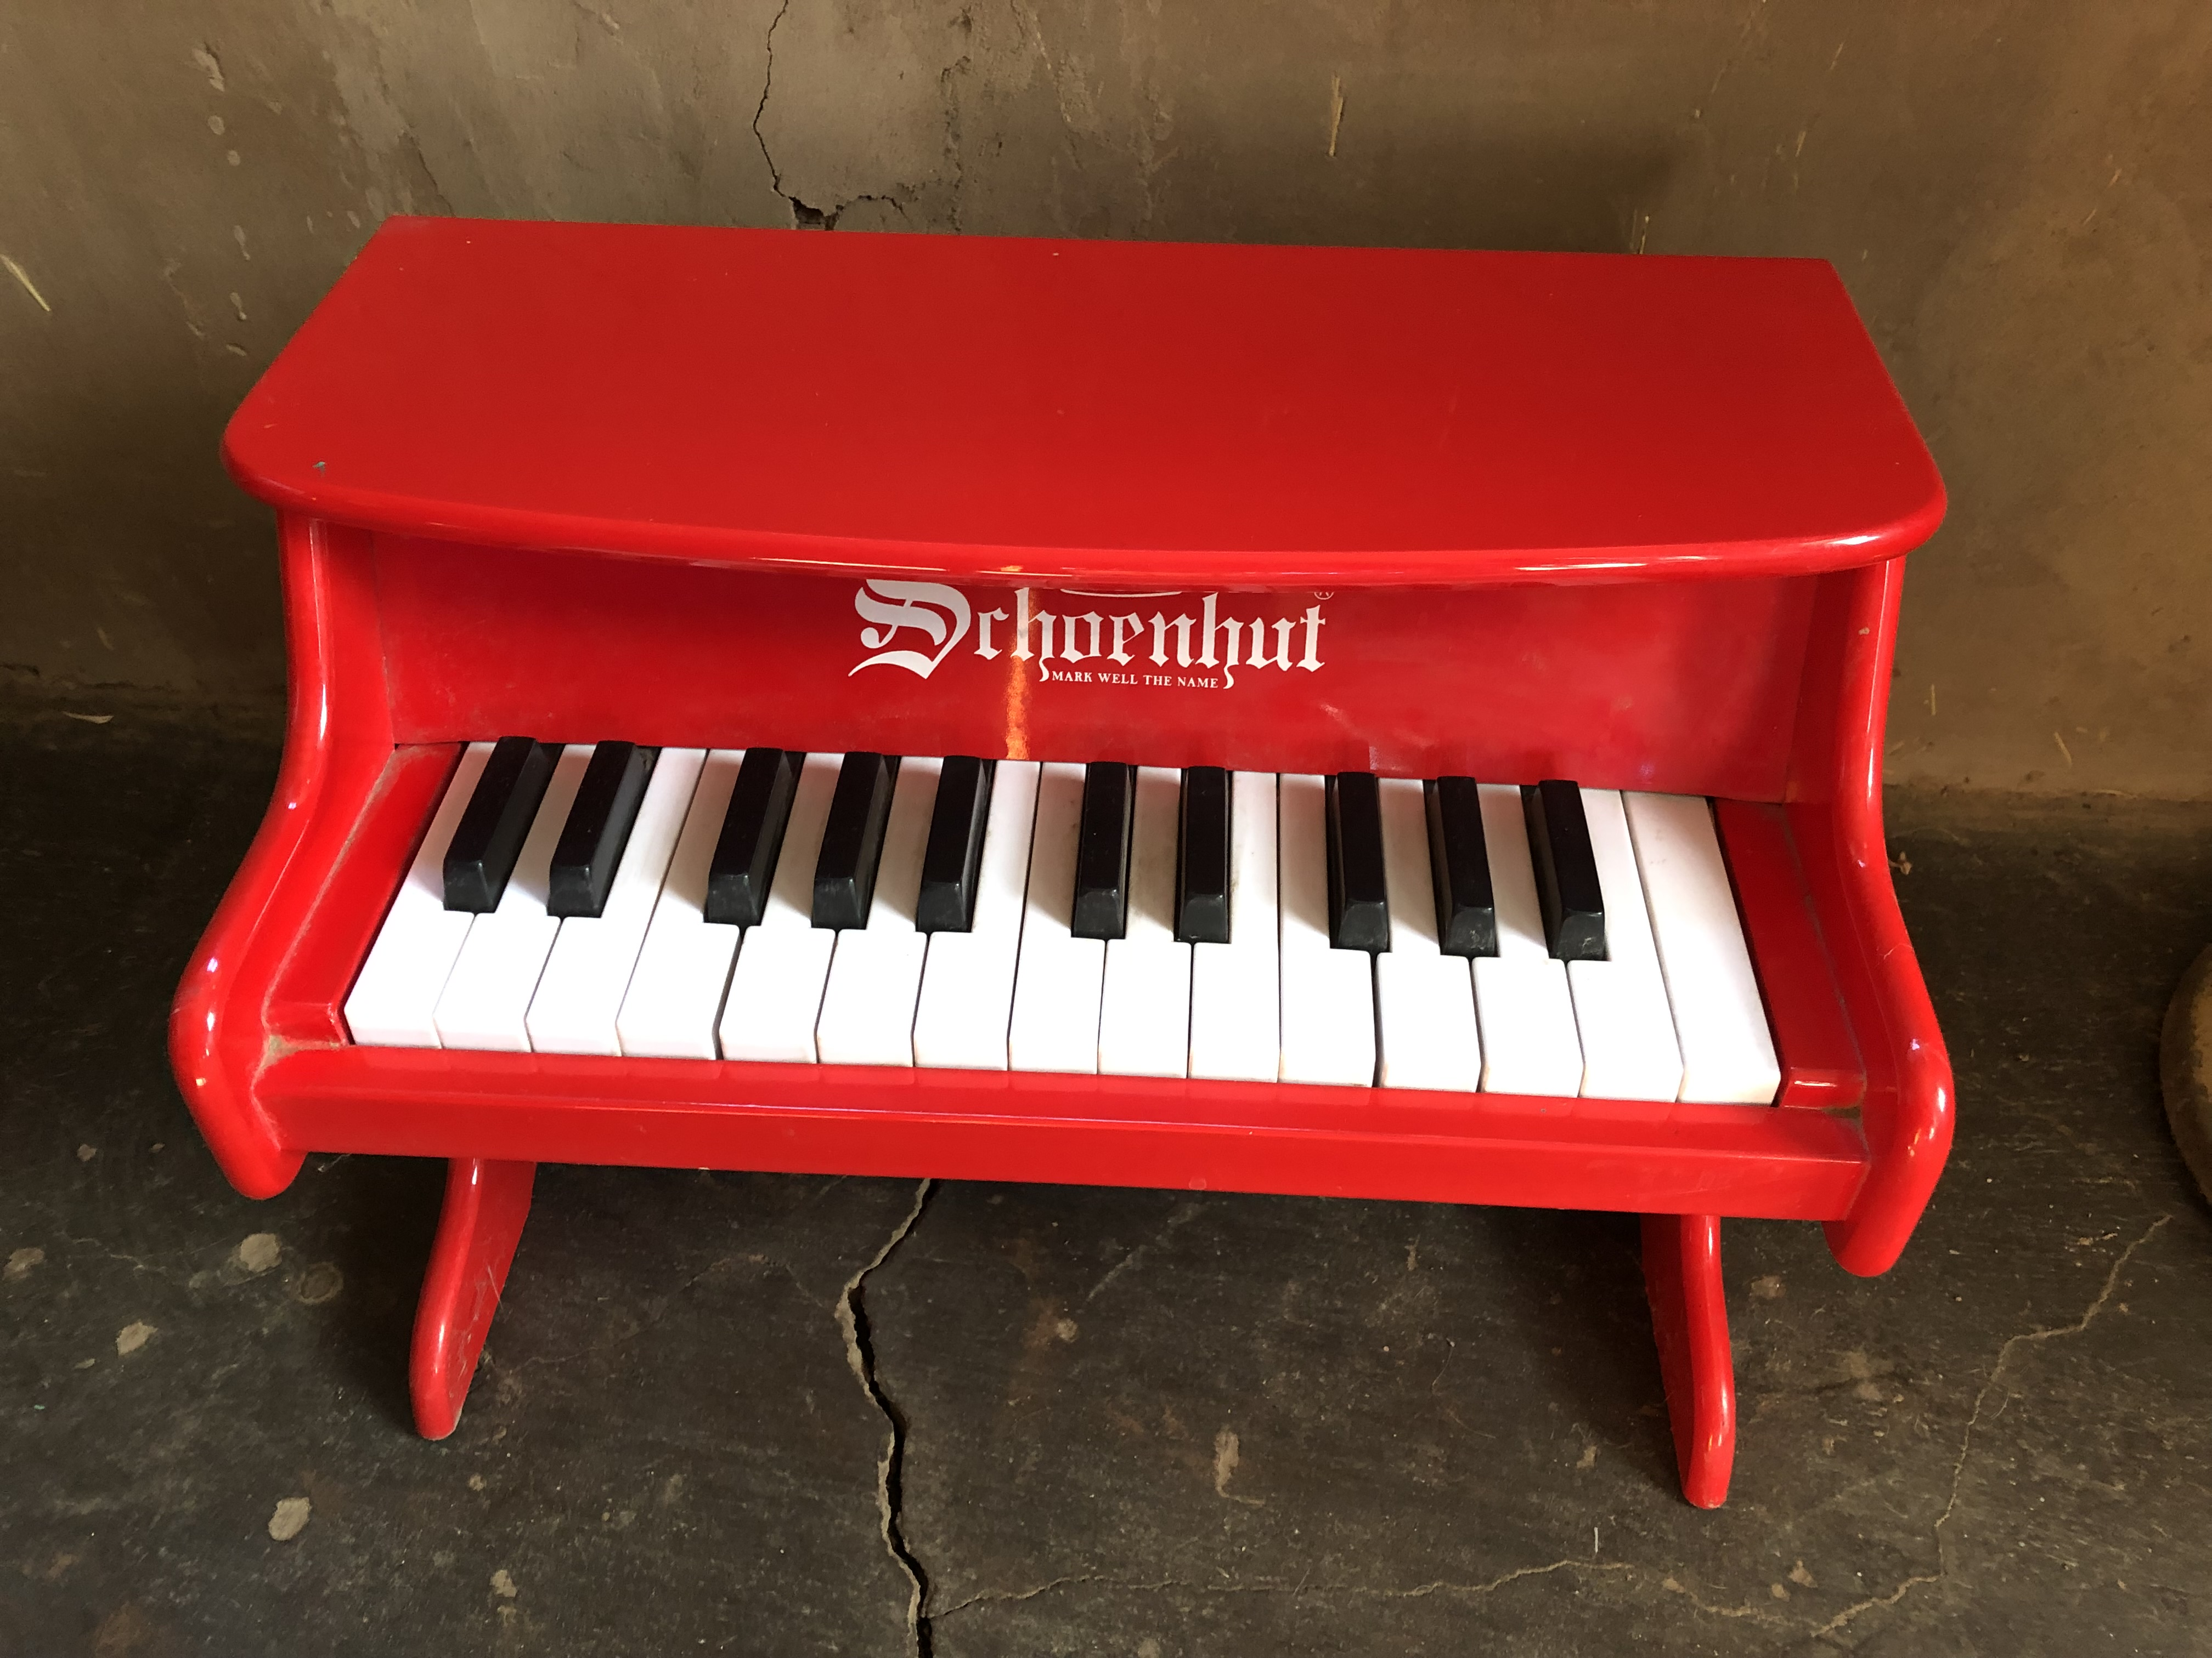
Aesthetic inspiration:

Slide 4
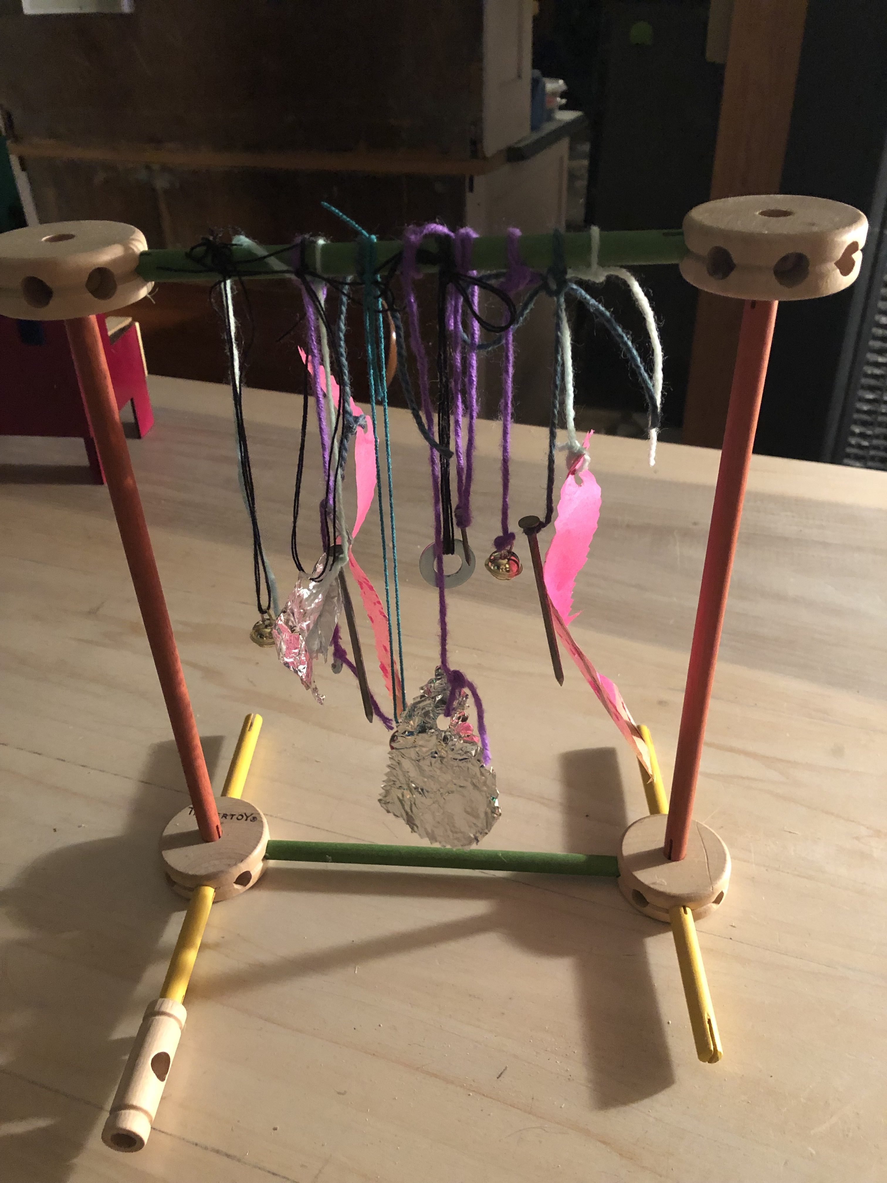
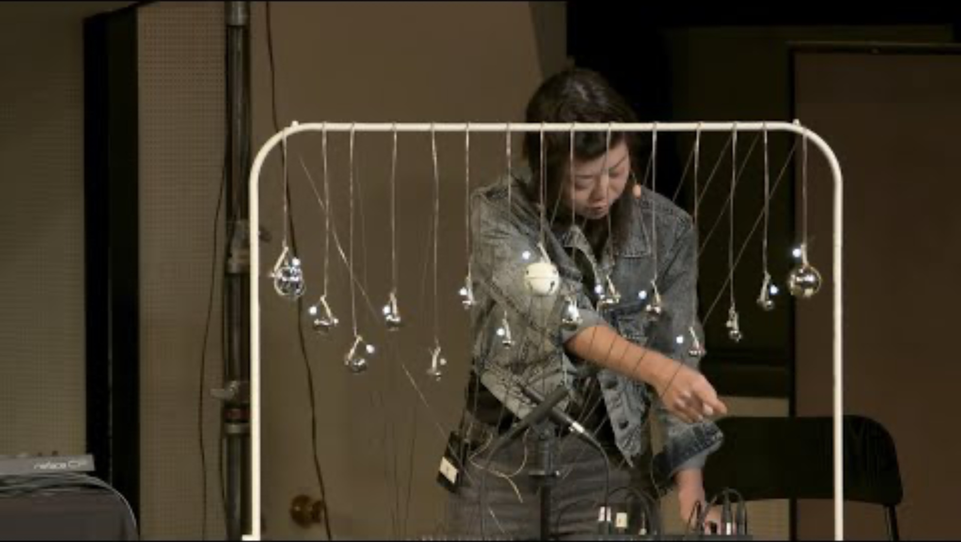
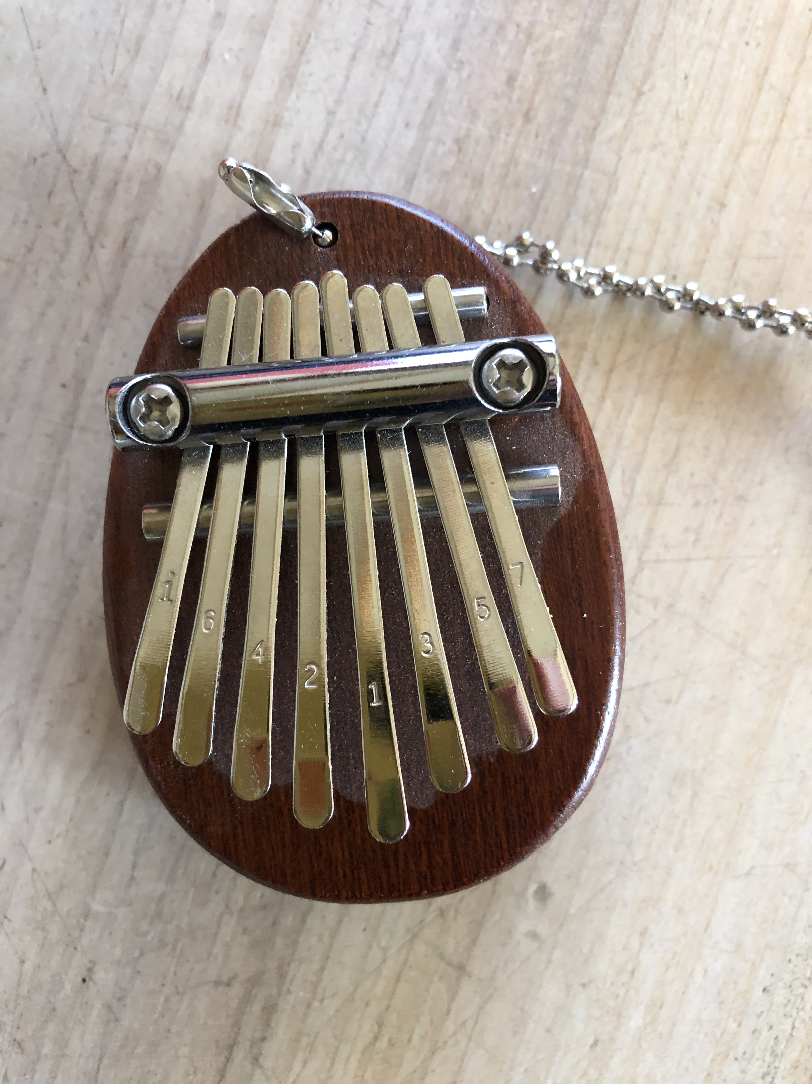
Hybrids:
Well, sort of…..
Idea for someday…..
“Touch, Code, Play: Creating Hybrid physical-digital Music Instruments| Loop”

Slide 5
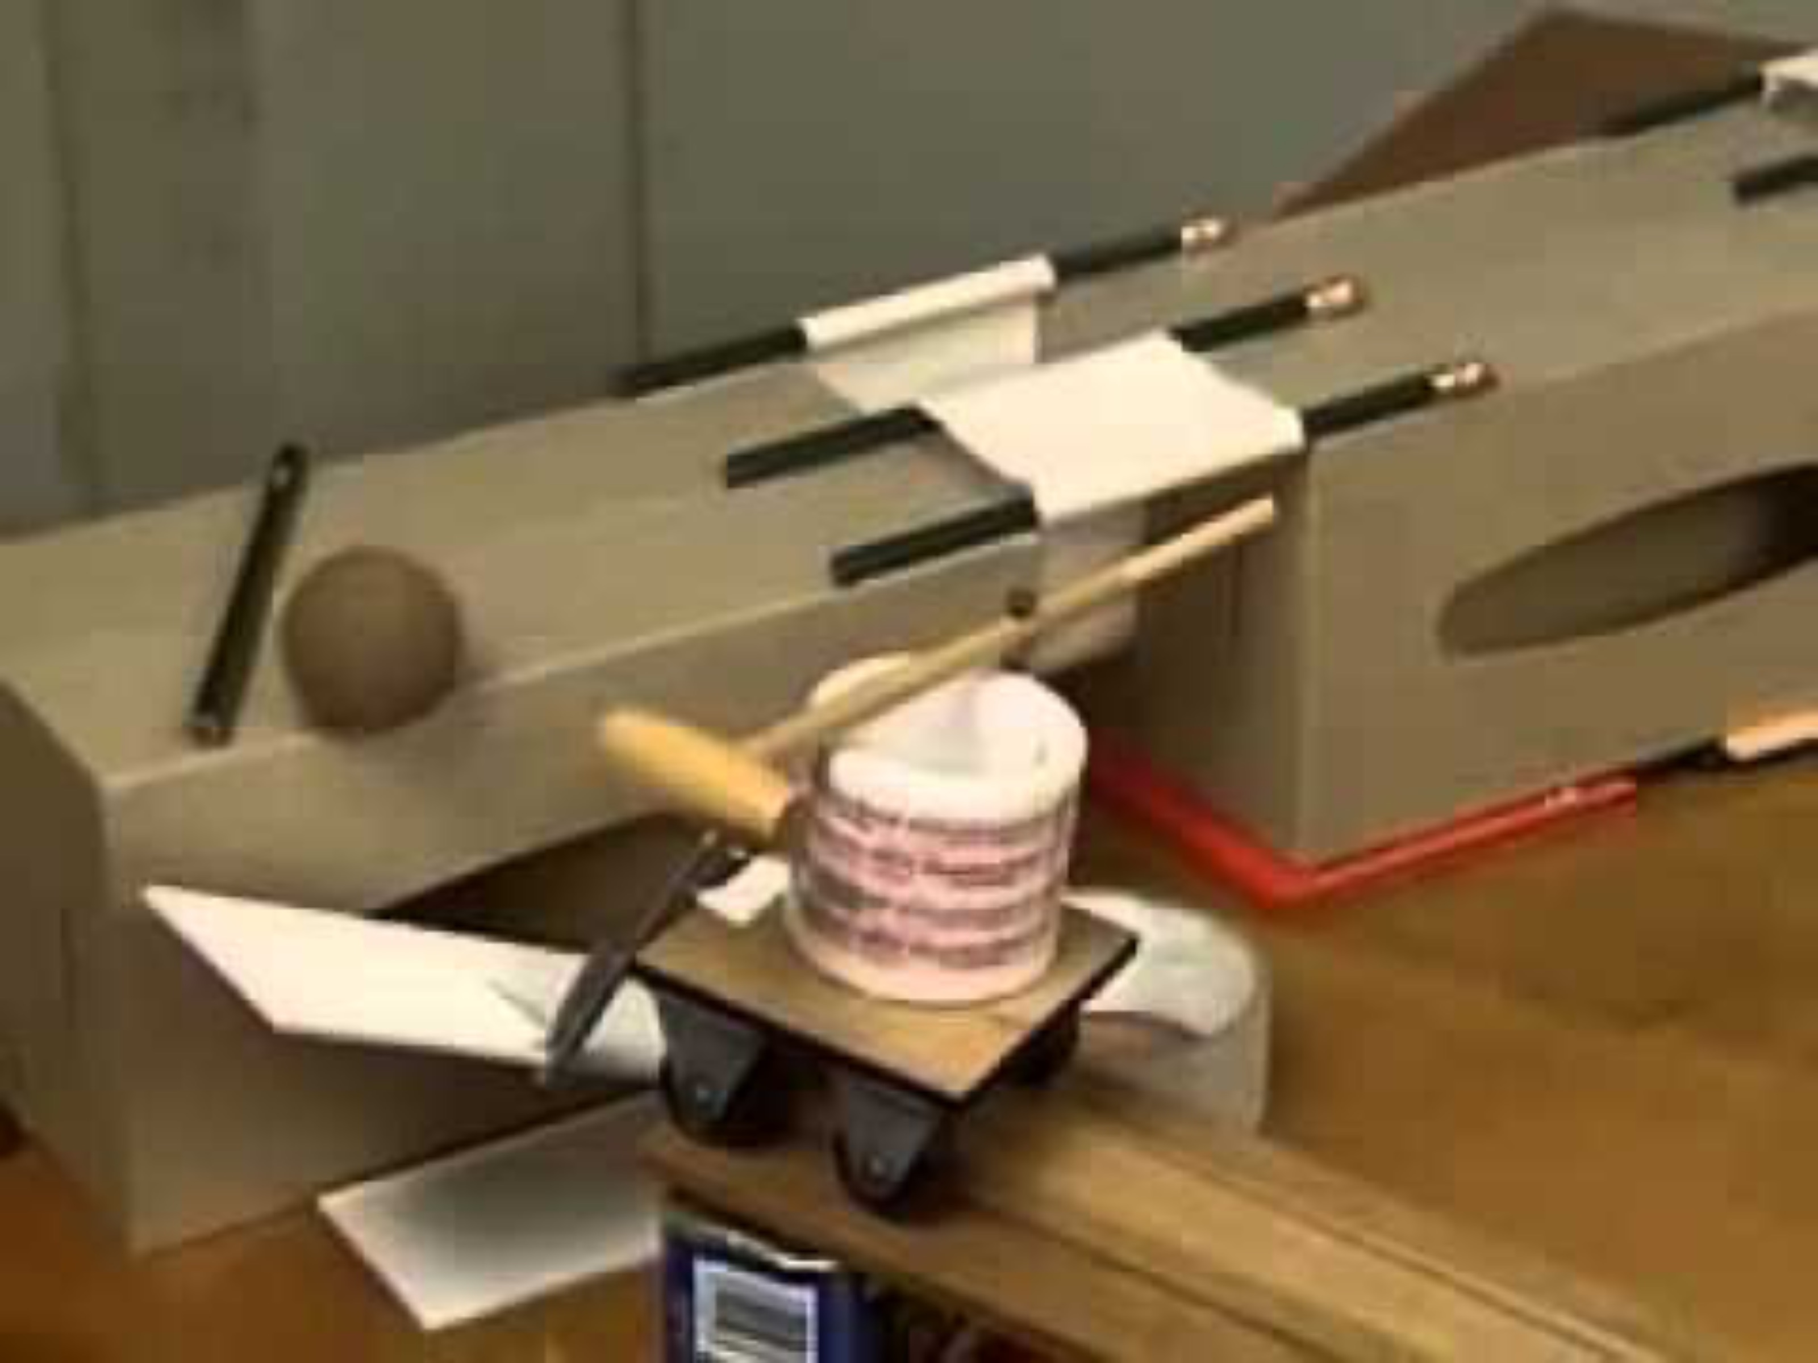
Cascade, unnecessary steps, mix of what’s manual/automatic
Initial flowchart:
Automatic mode?
Manual mode:
Turn spotlight on
Is color on?
Notes produced electronically—no code
FALSE
FALSE
Does diode reach threshold ?
TRUE
Rube Goldberg and chain reactions:
Turn on Wemo for Percussion
TRUE
Servo moves key
Key pushes button
Is button pushed?
FALSE
TRUE
Play note track
Also different modes:
Piano, Toy Piano, Thumb Piano
Light note color

Slide 6
How it ended up:
Is switch clicked?
Is switch clicked?
OLED:Automatic Mode
OLED: Manual Mode
Spotlight on
Spotlight off
Note=0
Note=0
Diode reach threshold?
FALSE
Button pushed?
FALSE
Note=key
Note=key
Play Note
FALSE
Play Note
Servo move key
FALSE
Is Note !=0?
Is Note !=0?
Wemo hit drum
Tone=0
Hue light off
Tone=0
Hue light off

Slide 7
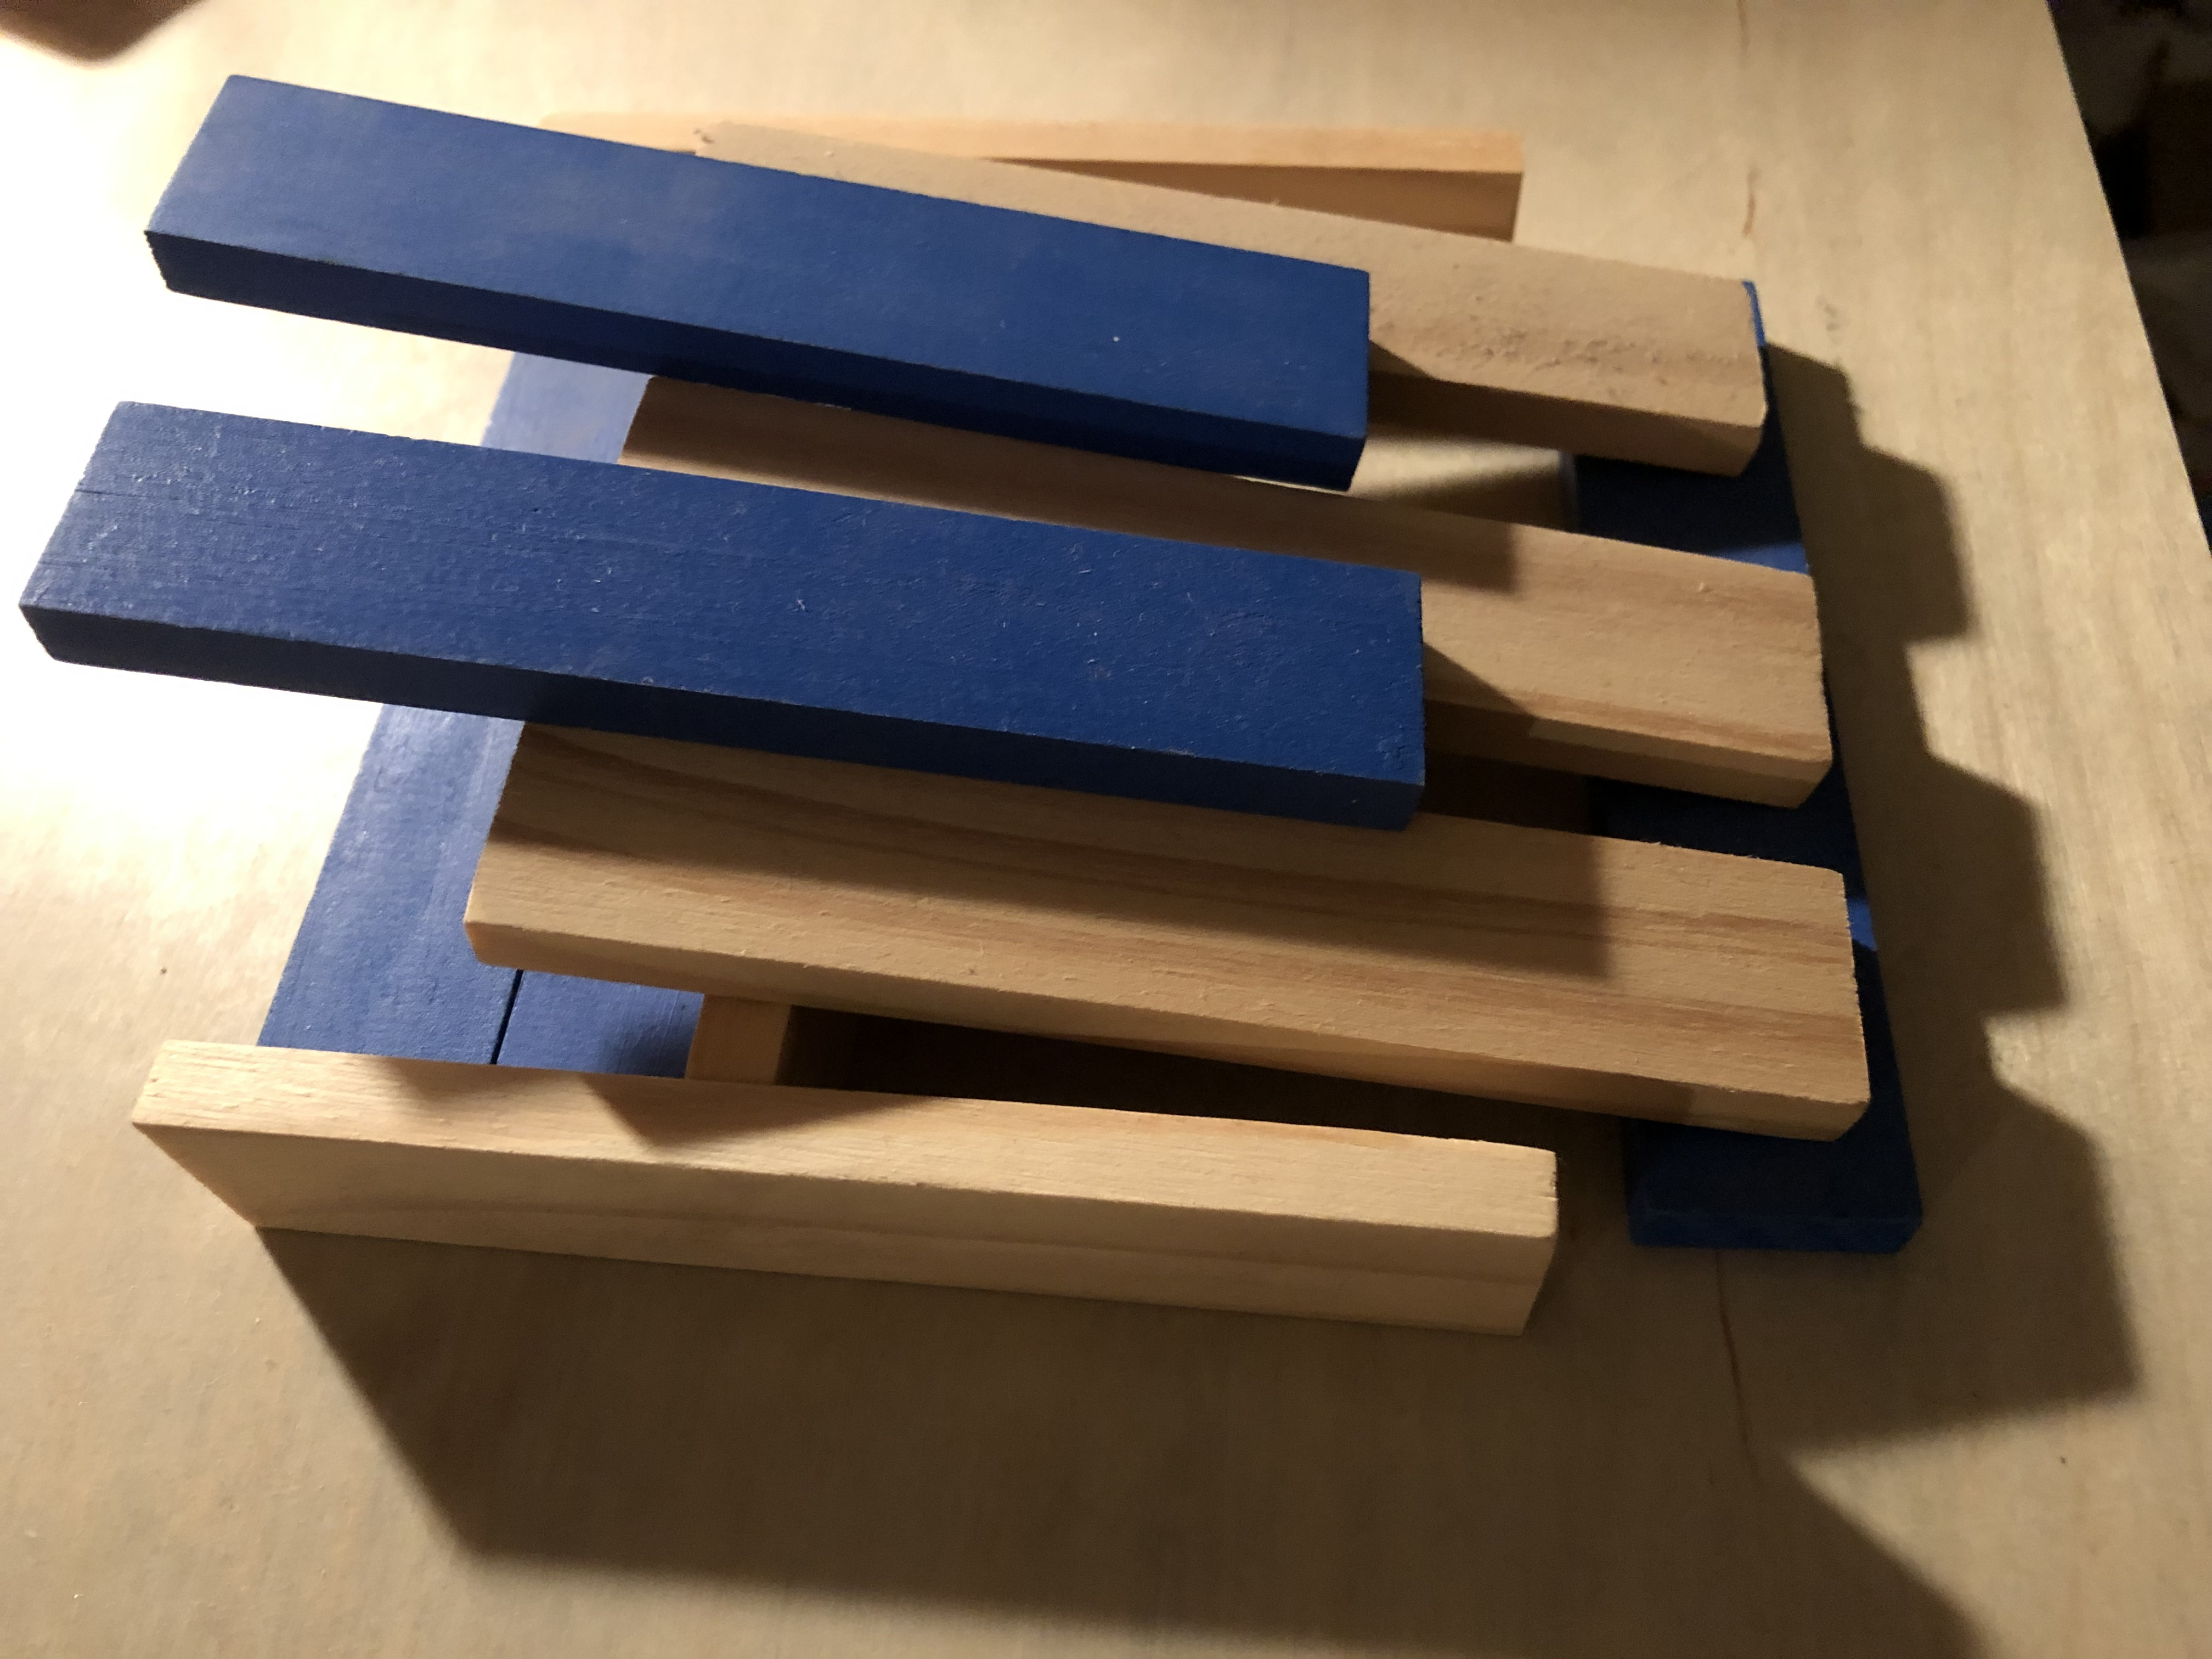
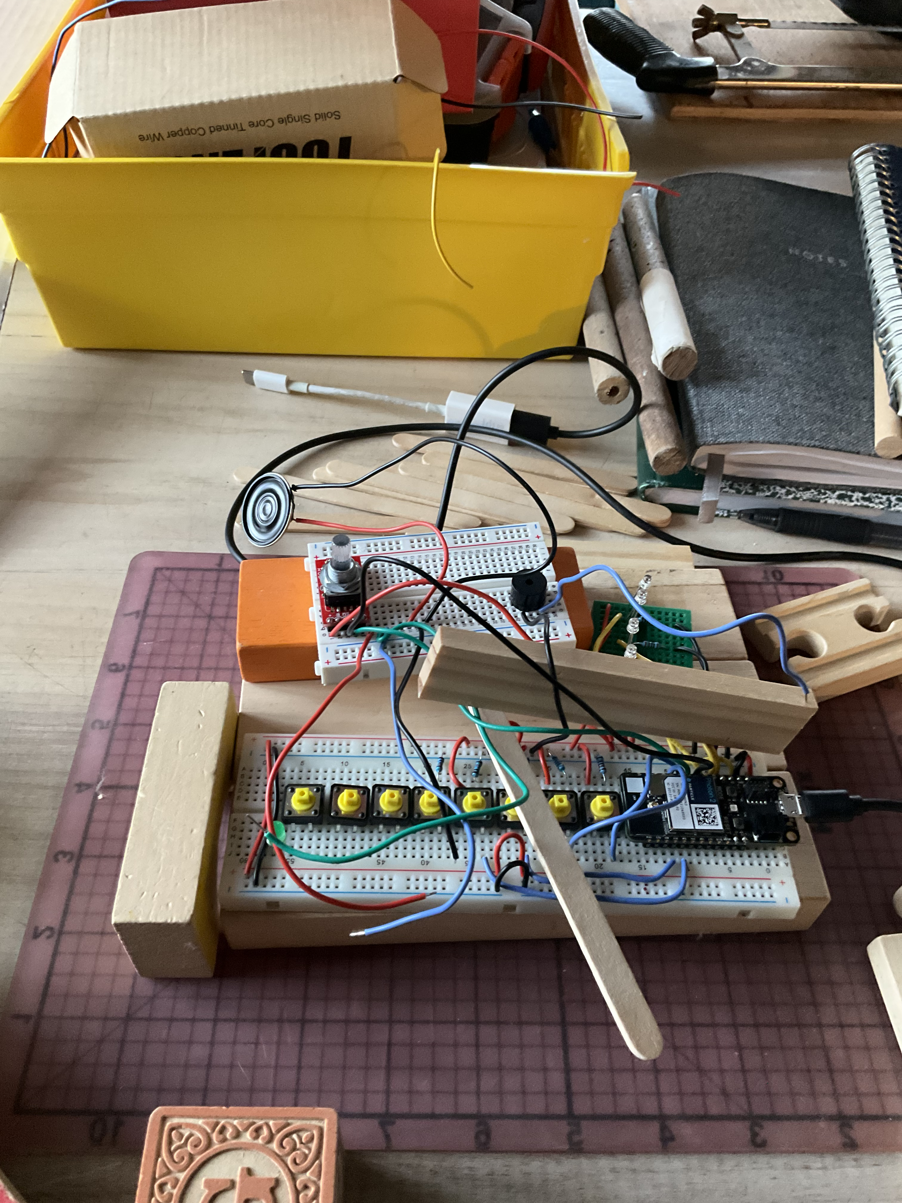
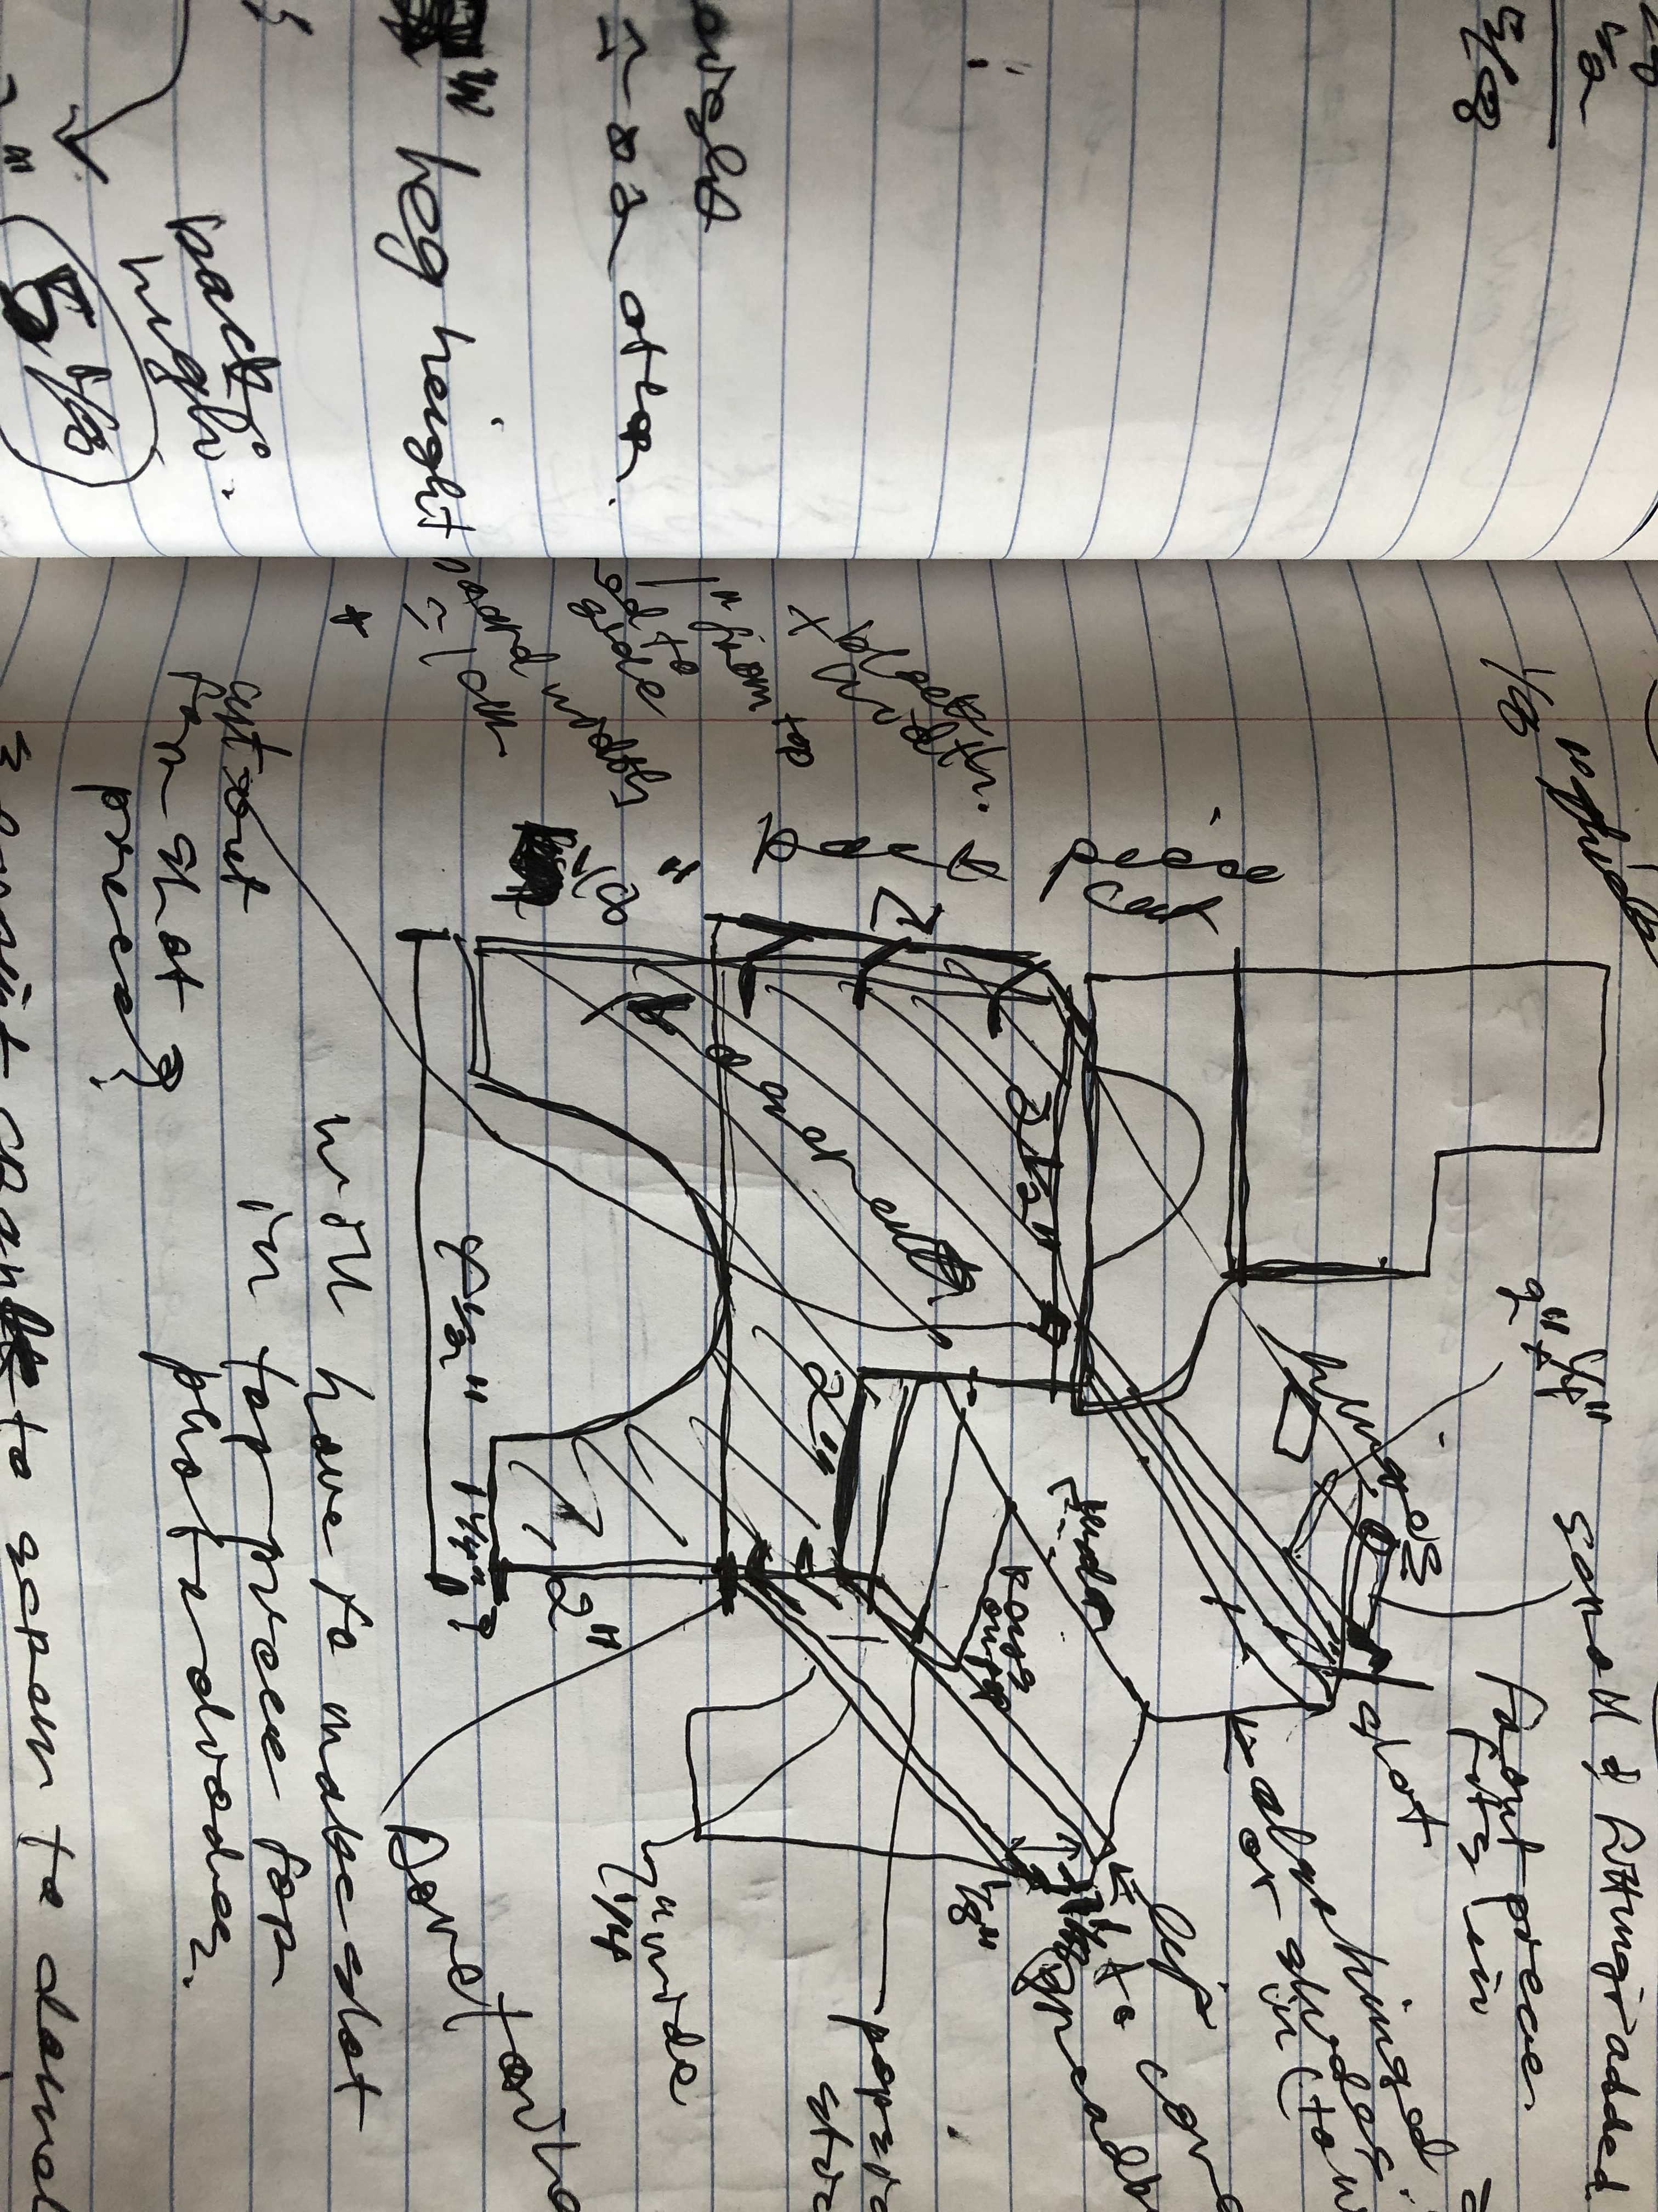
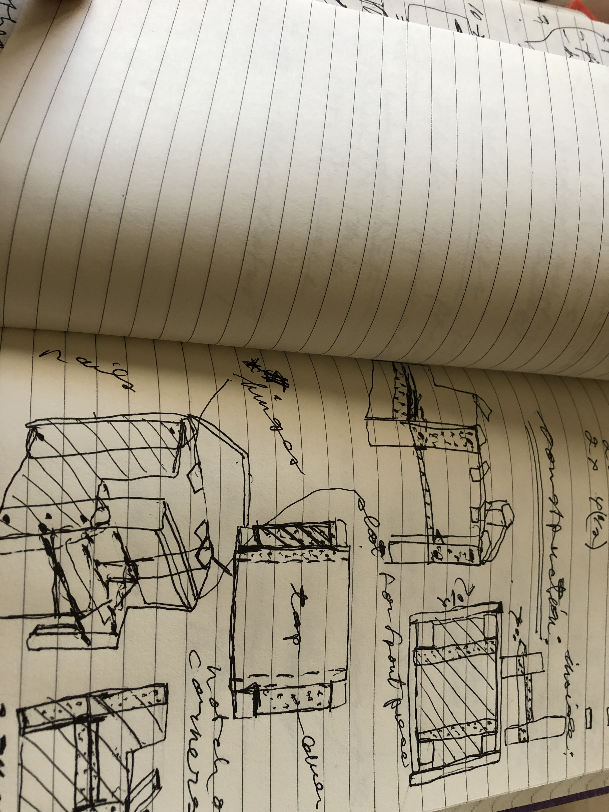
Challenges: Planning ahead sizes, designing mechanism…..

Slide 8
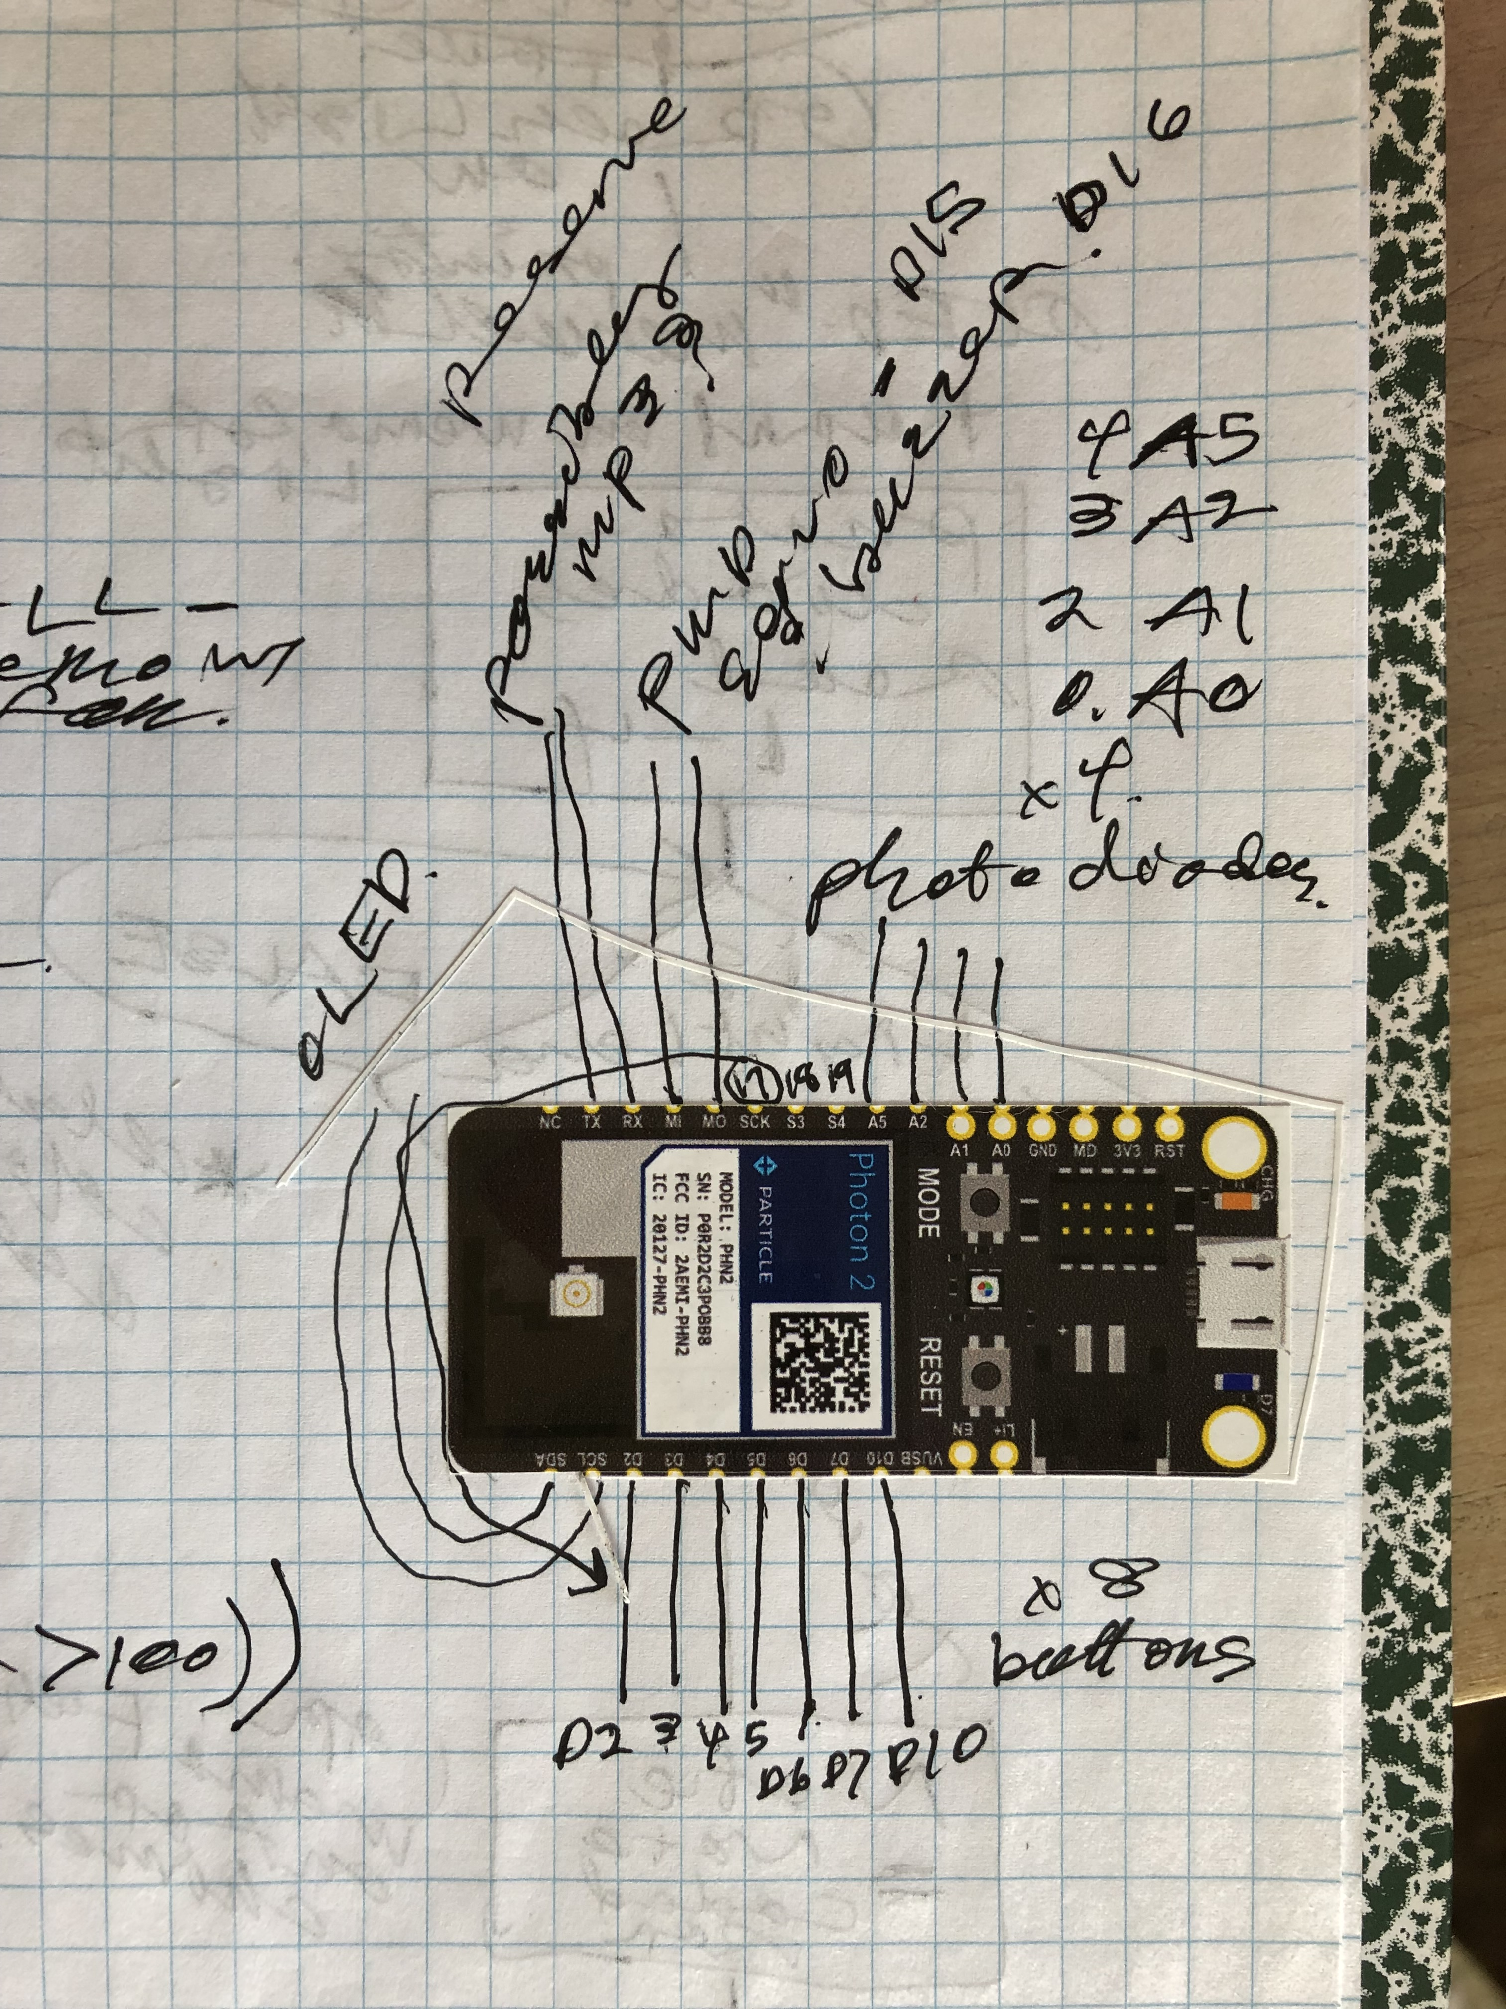
Space
Running out of pins:
Soft PWM? Drivers?

Slide 9
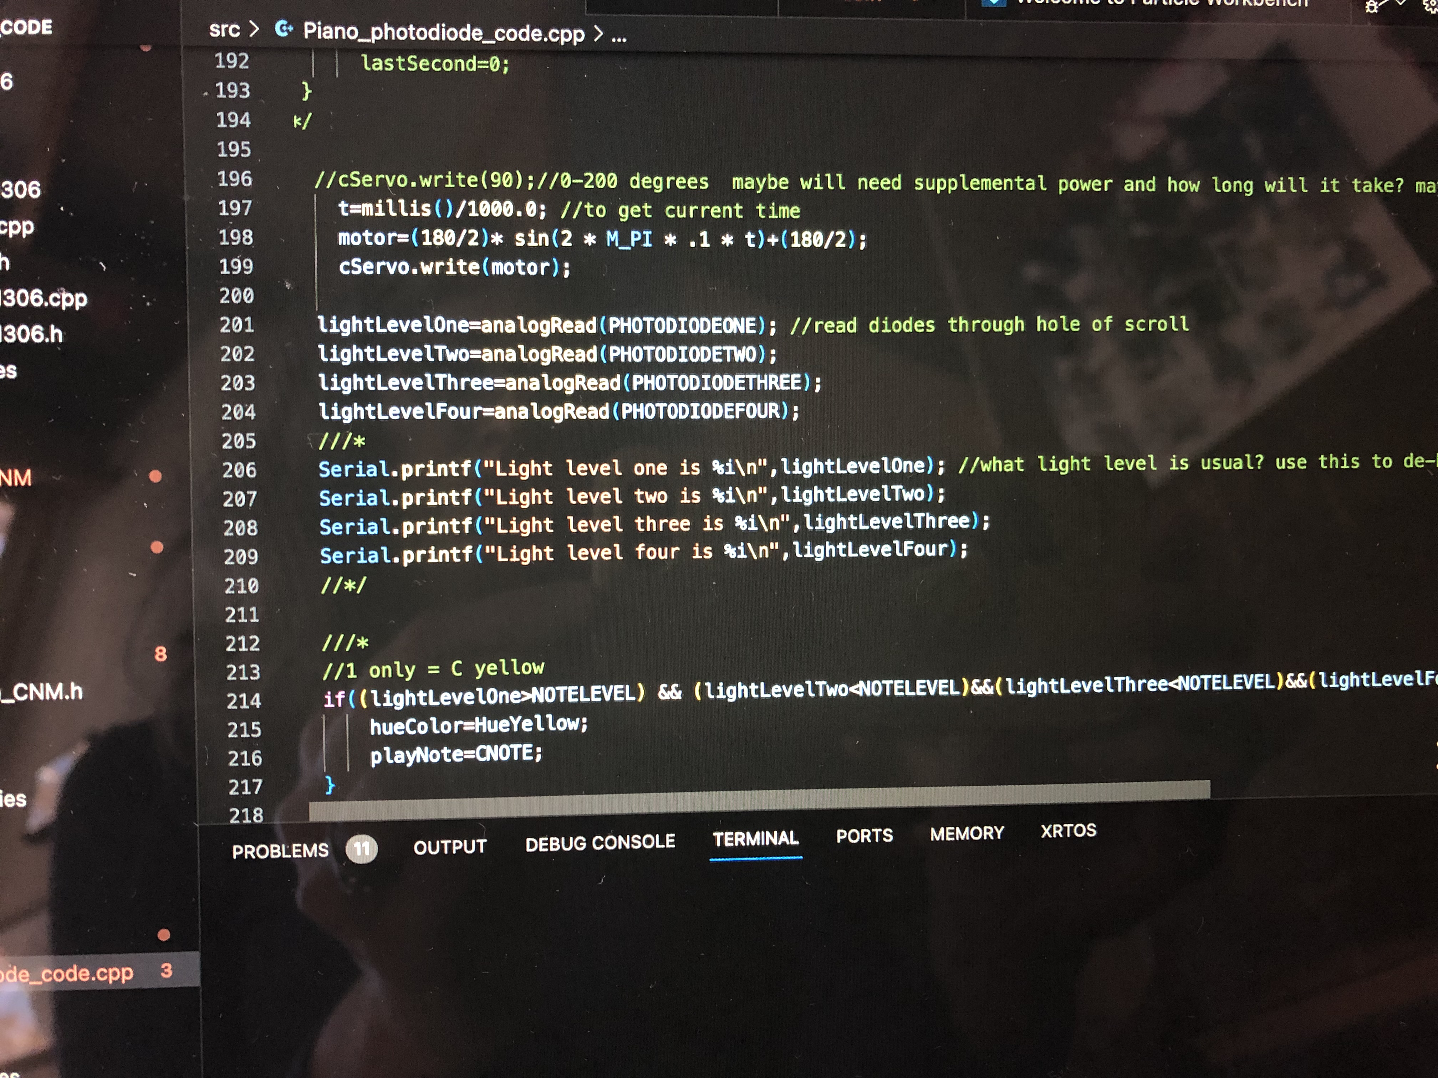
And of course, Code!

Slide 10
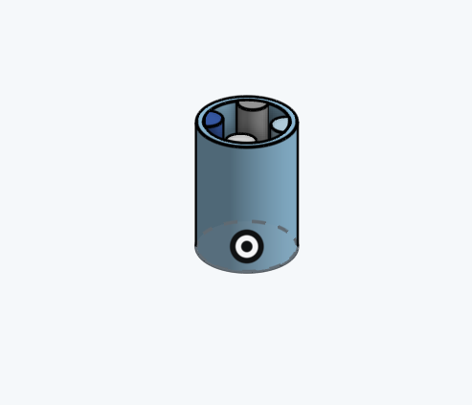
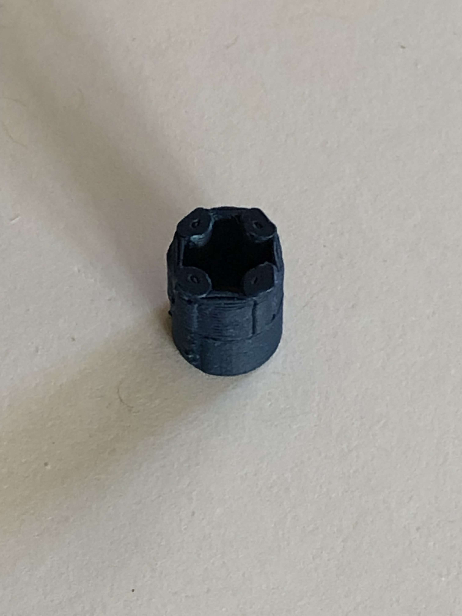
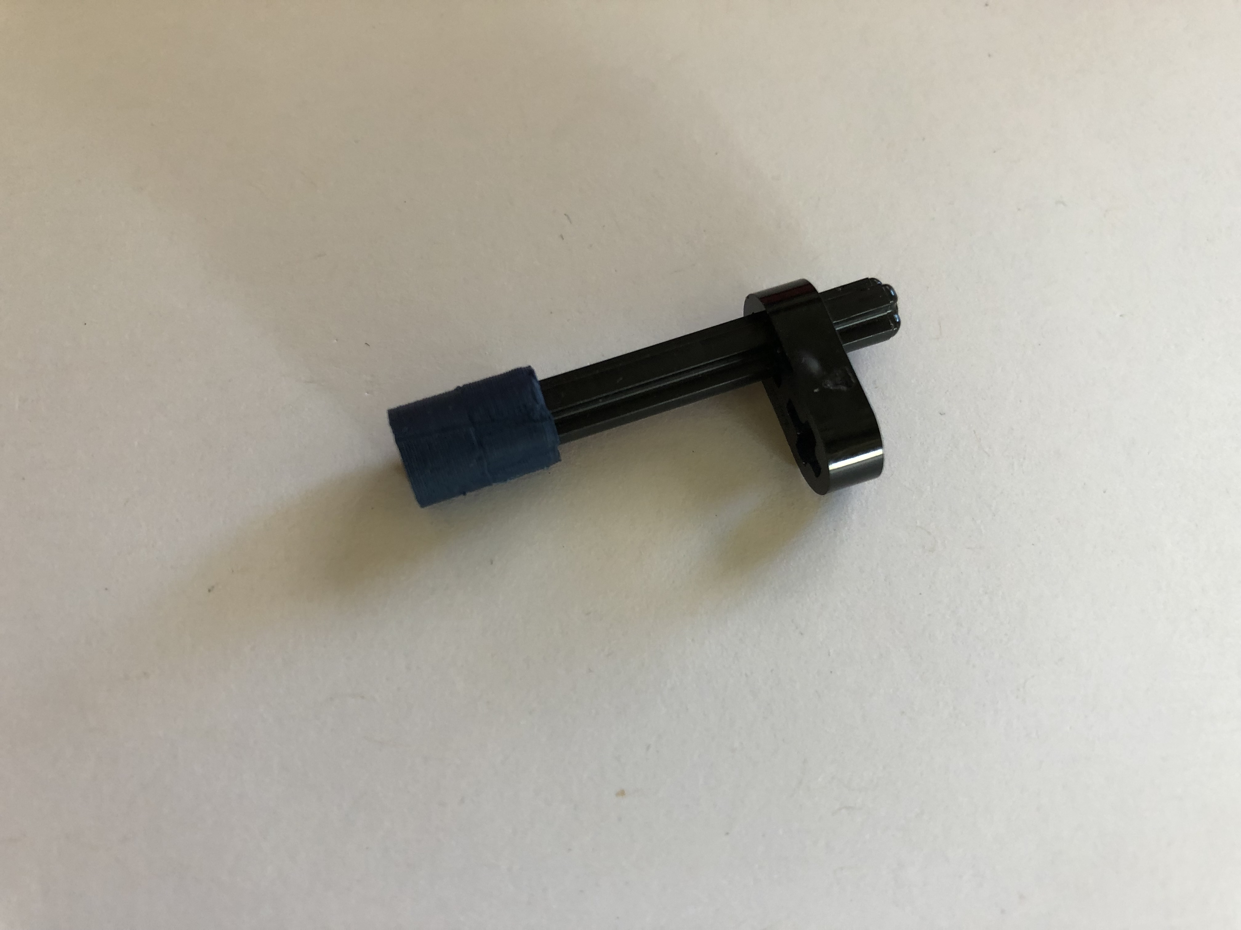
BIG (tiny) SUCCESS!
Fits perfectly!!!

